Slide 1
Using Blazor to Manage Data in SQL Server and Microsoft Fabric
Michael Washington
BlazorData.Net

Slide 2



About
Michael Washington

Slide 3




Blazor Books By Michael Washington

Slide 4
Forms Over Data
Blazor Data Sheet (SQL Server)
Using Fabric Warehouse
Agenda
Using Fabric Warehouse
Import data using parquet files
Blazor Data Sheet (Fabric)
Report Data using Blazor

Slide 5
Forms Over Data

Slide 6
Creating forms is the biggest cost in an application
Creating forms is often one of the most time-consuming and costly parts of building an application, but utilizing a Blazor DataSheet can significantly reduce both. By allowing users to view and update data directly within a flexible, grid-like interface, Blazor DataSheet eliminates the need for complex form-building, streamlining development and maintenance efforts.
Additionally, it supports custom validation, ensuring that specific business rules are enforced without the overhead of designing and managing traditional form structures. This approach not only saves time but also lowers development costs while maintaining robust data integrity.

Slide 7
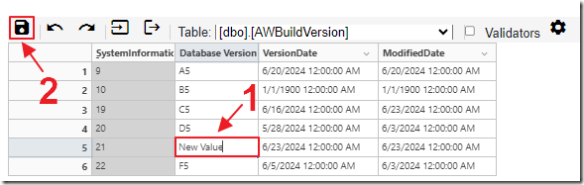
Blazor DataSheet (SQL Server)

Slide 8
The Application

Slide 9
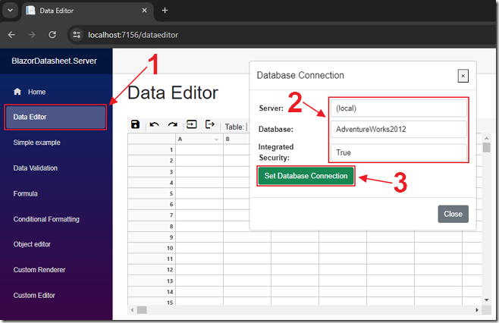
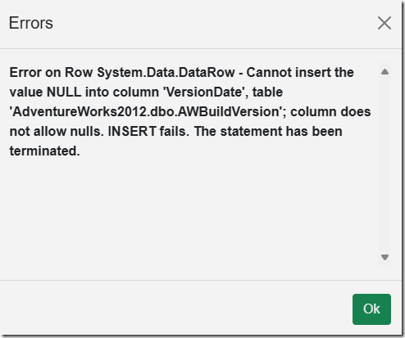
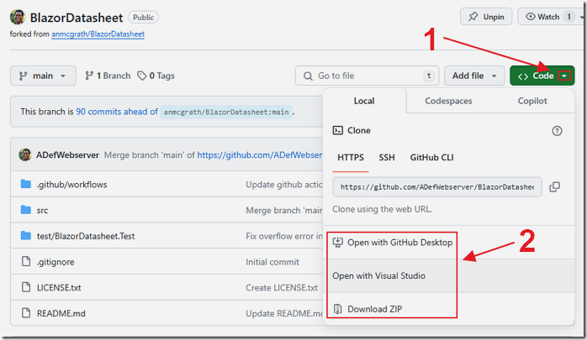
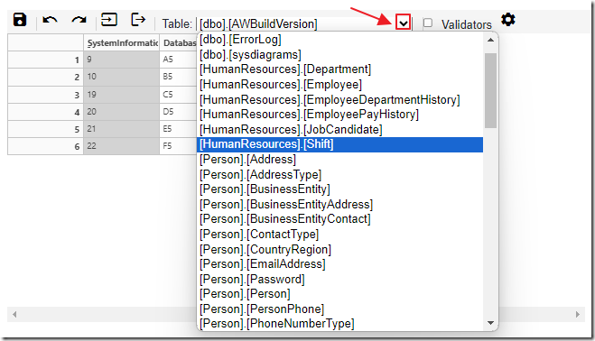
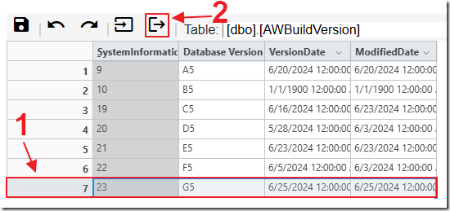
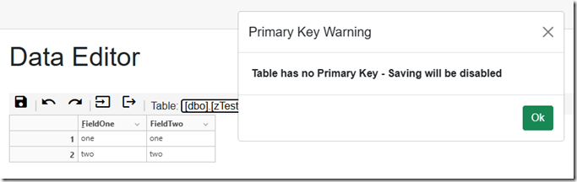
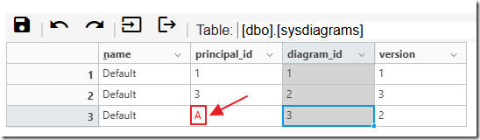
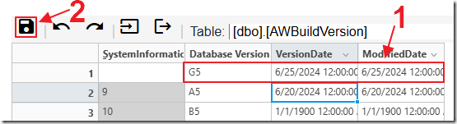
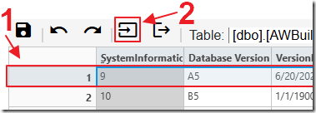
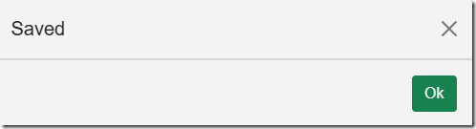
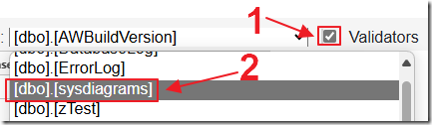

Slide 10
The Code

Slide 11
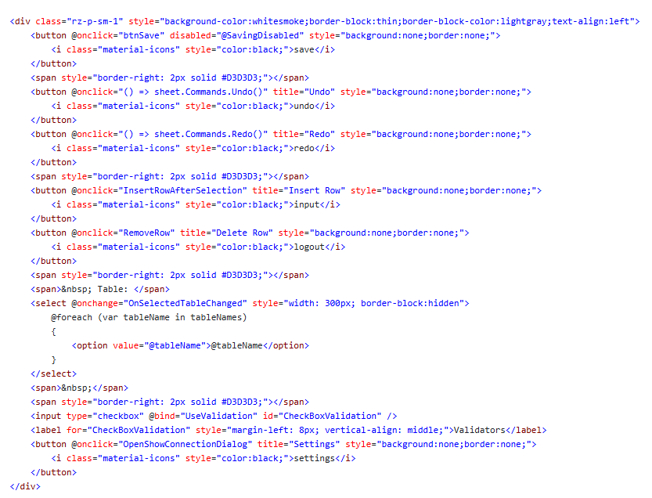
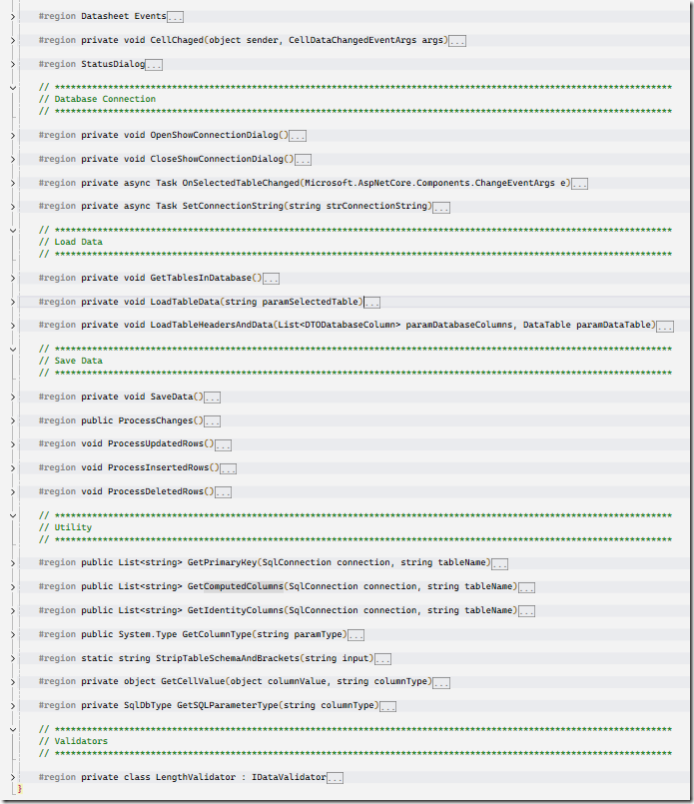
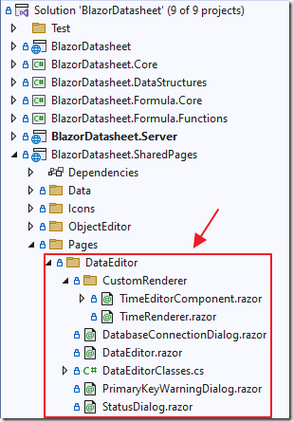
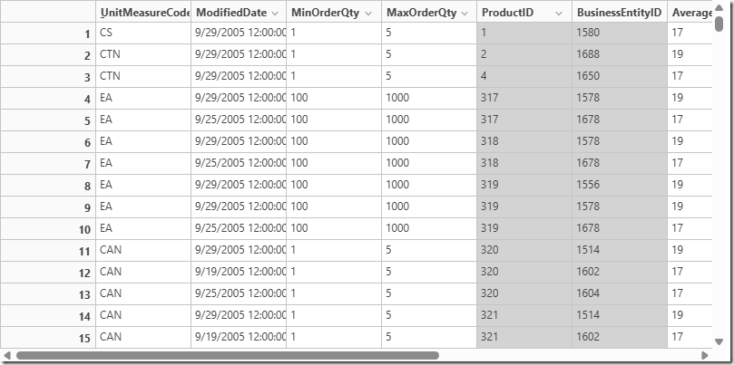
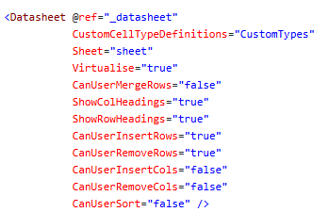

Slide 12
Loading Data
Retrieve Table Metadata:
Fetch primary keys using GetPrimaryKey and computed columns with GetComputedColumns.
Fetch and Filter Column Details:
Retrieve column details for selectedTable and populate TableColumns.
Filter out unwanted column types: uniqueidentifier, hierarchyid, varbinary, geography, and computed columns.
Build SQL Query:
Convert TableColumns to a comma-separated string of column names.
Construct the SQL query:
If no primary keys, disable saving, show a warning, and create a query without primary key ordering.
If primary keys exist, create a query with ROW_NUMBER() ordering by primary keys.
Execute SQL Query and Handle Data:
Use SqlDataAdapter to fill a DataTable (dt).
Save a copy of dt as OriginalDataTable.
Add _Id Column:
Insert _Id as the first column in TableColumns. This is used to determine if a row is new or is later deleted.
Load Data into Sheet:
Call LoadTableHeadersAndData with TableColumns and dt.

Slide 13
Loading Data into DataSheet
Create Sheet:
Create a new sheet with a number of rows and columns based on the input paramDataTable and paramDatabaseColumns.
Hide _Id Column:
Hide the first column (_Id )
Set Column Headings and Types:
Loop through paramDatabaseColumns to set column headings and cell types.
Use the ColumnRegion class to specify the region for column types and validators.
(If enabled) Apply different validators based on column type and length:
Integer Validator for columns containing “int”.
Length Validator for columns with specified lengths and types containing “char”.
Load Data into Sheet:
Loop through paramDataTable.Rows to load data into the sheet cells.
Set cell values using a helper function GetCellValue that handles data type conversion.
If the column is a primary key, set the cell to read-only and change the background color to light grey.
Wire Up Event Handlers:
Cell Changes: Attach a method to handle cell changes (CellChanged).
Row Changes: Attach a method to handle row deletions. Prevent deletion of the last row by inserting a new row if necessary.

Slide 14
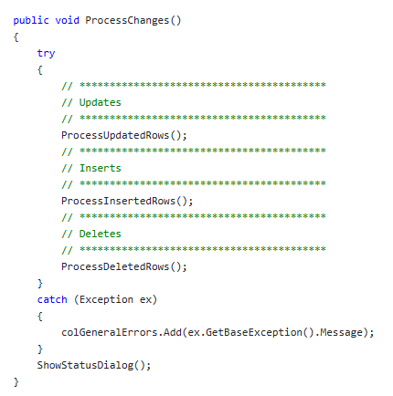
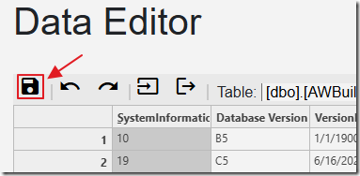

Slide 15
Update Data
Processing Each Changed Row:
foreach (int row in ColChangedRows)
Iterates over each unique row ID in ColChangedRows.
Skipping Invalid Rows:
if (row == 0) continue;
Skips processing if the row ID is 0.
Retrieving Current Data Row:
DataRow rowCur = CurrentDataTable.Select($"_Id = {row}").FirstOrDefault();
Selects the first row from CurrentDataTable where _Id matches the current row ID.
Initializing Lists for SQL Statements and Parameters:
Initializes colSQLUpdateColumns, colSQLWhereColumns, and parameters as empty lists.
Building SQL Update and Where Clause Lists:
Iterates over each column in TableColumns starting from index 1 (assumes index 0 is _Id).
Retrieves column details: columnName, columnType, and columnLength.
Sanitizes the parameter name by replacing spaces with underscores.
Gets the value for the current column from rowCur.

Slide 16
Update Data
Adding Primary Key Columns to WHERE Clause:
If the column is a primary key:
Adds to colSQLWhereColumns.
Creates a corresponding SqlParameter with the _where suffix.
Adding Non-Primary Key Columns to UPDATE Clause:
If the column is not a primary key:
Adds to colSQLUpdateColumns.
Creates a corresponding SqlParameter.
Executing SQL Update Command:
If there are columns to update (colSQLUpdateColumns.Any()):
Constructs the UPDATE SQL statement with SET and WHERE clauses.
Opens a SQL connection using DatabaseConnectionString.
Executes the UPDATE command with the constructed SQL and parameters.
Catches and logs any exceptions that occur during execution.
Ensures the SQL connection is closed after execution.

Slide 17
Add Data
Finding Added Rows:
var addedRows = CurrentDataTable.AsEnumerable().Where(row => row.Field<object>("_Id") == null).ToList();
Identifies rows in CurrentDataTable where the _Id field is null (indicating newly added rows) and stores them in the addedRows list.
Getting Identity Columns:
List<string> colIdentityColumns = new List<string>();
Initializes an empty list to store identity columns.
using (SqlConnection connection = new SqlConnection(DatabaseConnectionString))
Opens a SQL connection using DatabaseConnectionString.
Retrieves identity columns using the GetIdentityColumns method.
Closes the connection in the finally block to ensure it is closed even if an error occurs.
Looping Through Added Rows:
foreach (var rowCur in addedRows)
Iterates over each newly added row.

Slide 18
Add Data
Initializing Lists for SQL Statements and Parameters:
Initializes colSQLUpdateColumns and parameters as empty lists.
Building SQL Insert Columns and Parameters:
Iterates over each column in TableColumns starting from index 1 (assumes index 0 is _Id).
Checks if the column is not an identity column.
Retrieves column details: columnName and columnType.
Sanitizes the parameter name by replacing spaces with underscores.
Adds the column name to colSQLUpdateColumns.
Retrieves the value for the current column from rowCur.
Creates a corresponding SqlParameter.
Executing SQL Insert Command:
If there are columns to insert (colSQLUpdateColumns.Any()):
Constructs the INSERT SQL statement with column names and parameter names.
Opens a SQL connection using DatabaseConnectionString.
Executes the INSERT command with the constructed SQL and parameters.
Catches and logs any exceptions that occur during execution.
Ensures the SQL connection is closed after execution.

Slide 19
Delete Data
Retrieve Non-null _Id Values:
Filter CurrentDataTable to get rows where _Id is not null.
Extract _Id values into a list called currentIds.
Convert _Id Values to Long:
Convert currentIds (originally of type int) to a list of long values called longCurrentIds.
Identify Deleted Rows:
Filter OriginalDataTable to get rows whose _Id values are not present in longCurrentIds.
Process Each Deleted Row:
Initialize colSQLWhereColumns for the SQL WHERE clause and parameters for SQL parameters.
Loop Through Columns:
Skip the _Id column and iterate through the rest.
For primary key columns:
Add an SQL condition to colSQLWhereColumns.
Create a SqlParameter with the column value and add it to parameters.
Execute Delete Command:
If there are conditions in colSQLWhereColumns, form the SQL DELETE command.
Open a database connection.
Prepare and execute the SQL DELETE command using SqlCommand with the specified parameters.
Handle Exceptions:
Catch and log any exceptions, adding error details to colGeneralErrors.
Ensure the database connection is closed after each operation.

Slide 20
Using Fabric Warehouse

Slide 21
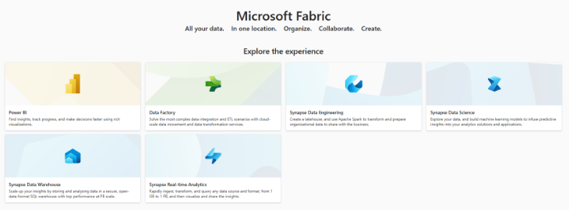
Microsoft Fabric is an end-to-end analytics and data platform designed to unify various data-related tasks into a single, cohesive solution. It integrates data movement, processing, ingestion, transformation, real-time event routing, and report building, all within a Software as a Service (SaaS) model.
By combining components from Power BI, Azure Synapse Analytics, and Azure Data Factory, Microsoft Fabric offers a comprehensive suite of services including Data Engineering, Data Science, Real-Time Analytics, and Data Warehousing. This integration enables businesses to transition raw data into actionable insights seamlessly

Slide 22
Connect To Fabric

Slide 23
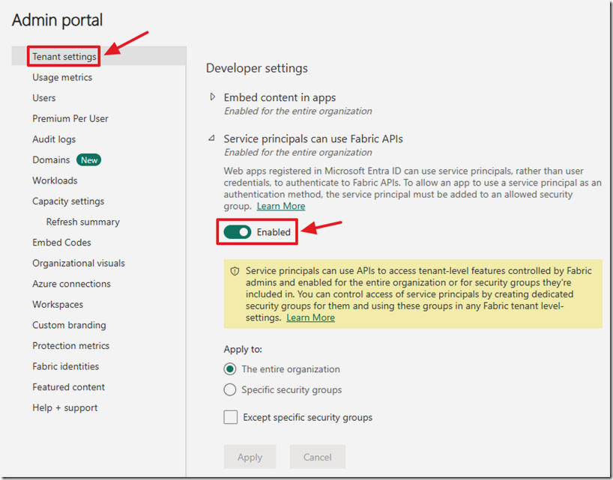
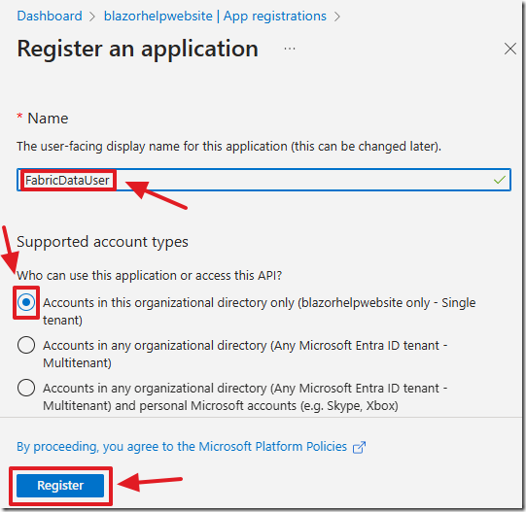
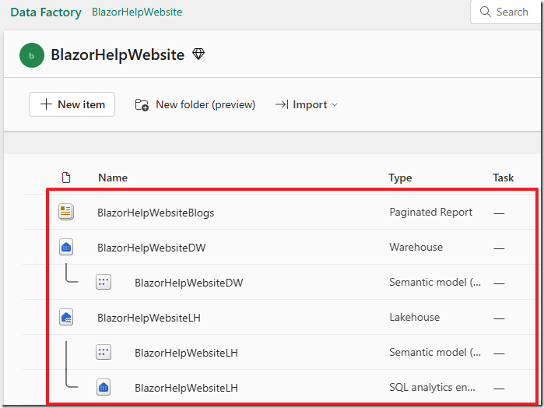
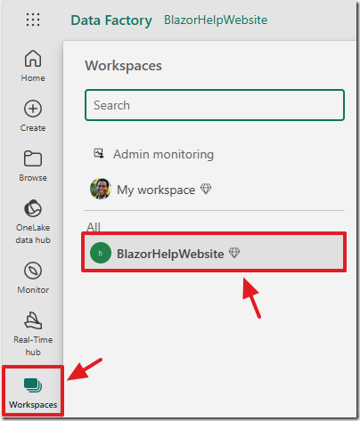
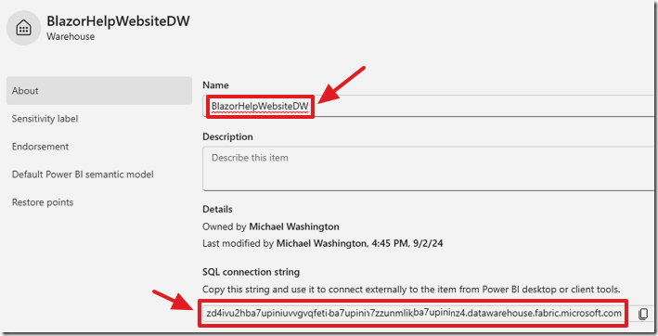
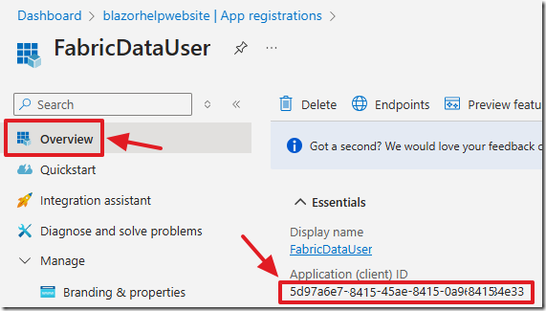
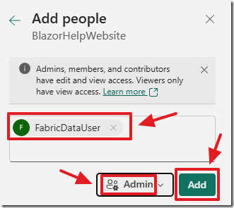
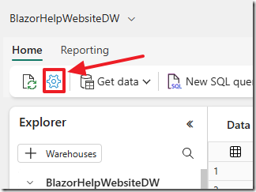
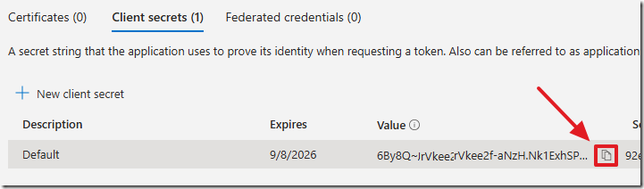
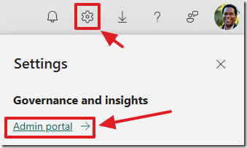

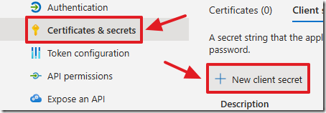
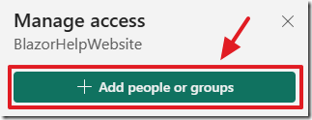
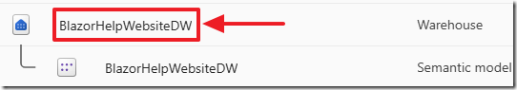
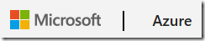
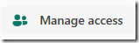

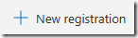


Slide 24
Connect using Microsoft SQL Server Management Studio

Slide 25
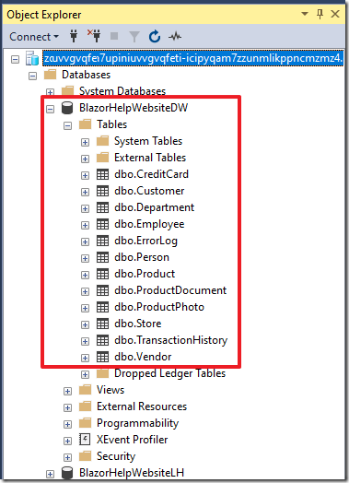
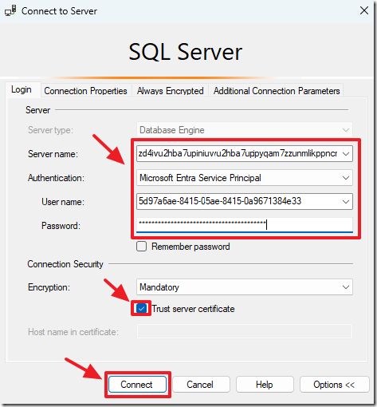
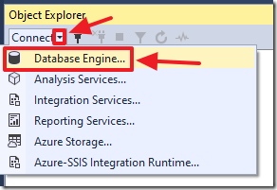

Slide 26
Connect using Microsoft Blazor

Slide 27
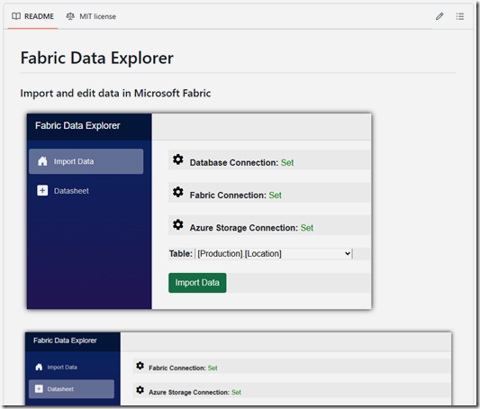
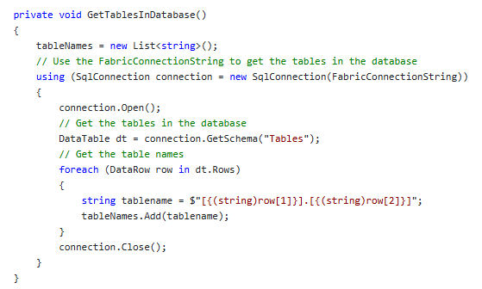
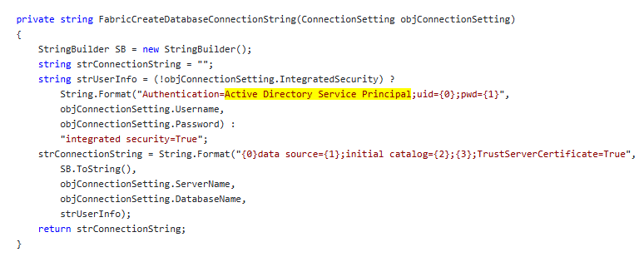
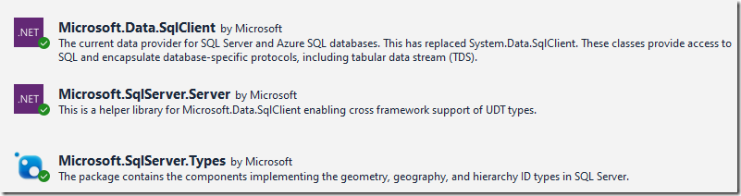
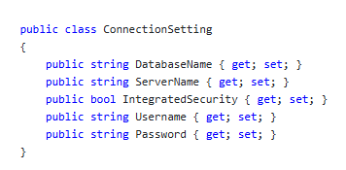

Slide 28
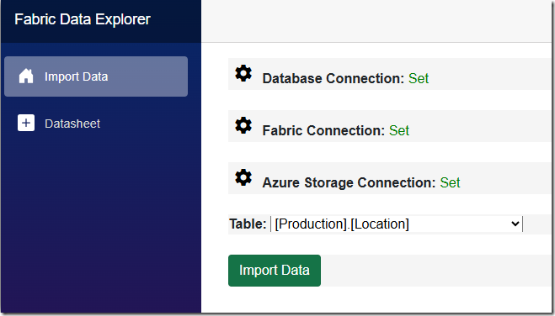
Import data using parquet files

Slide 29
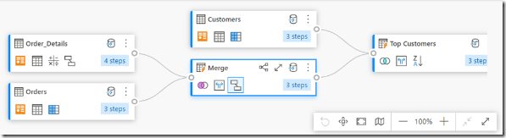
The standard way to import data into Fabric is:
Data pipelines: Provides a code-free or low-code way to manage data ingestion, allowing you to build complete ETL workflows. You can prepare the destination, run custom SQL, perform lookups, and move data between sources and destinations.
Dataflows: Are a simpler alternative focused on easy data preparation, cleaning, and transformation without needing any code.

Slide 30
Here are the Problems:
When something goes wrong you're stuck
There is no step-by-step debugging. You have to diagnose problems by examining the logs but these are often missing important information to understand exactly what is going wrong.
It is not very fast
Difficult to learn and hard to understand
Complex solutions created by others, and sometimes yourself, require a lot of clicking and drilling down into various settings to understand what a pipeline is doing

Slide 31
A Fast Way to Import Data Into Fabric
Create parquet file
Parquet is a the native format of data in the Fabric warehouse. However, it is being used in this instance as a way to compress the data into a format that is easily imported into Fabric
Import Parquet file into Azure Storage
The parquet file must be placed in a location that allows the TSQL statement: COPY INTO to import the data. Azure Storage provides such a location. a SAS token will be created to allow Fabric the authentication to access the parquet file
Use COPY INTO to import the parquet file into Fabric
This TSQL statement can import a parquet file that has a million rows in seconds.
Create parquet file from the data
Import parquet file in Azure storage
Use COPY INTO to import the parquet file into Fabric

Slide 32
The Application

Slide 33
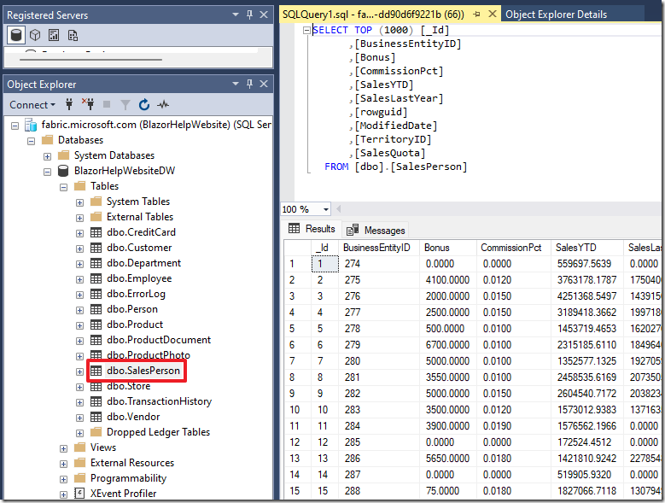
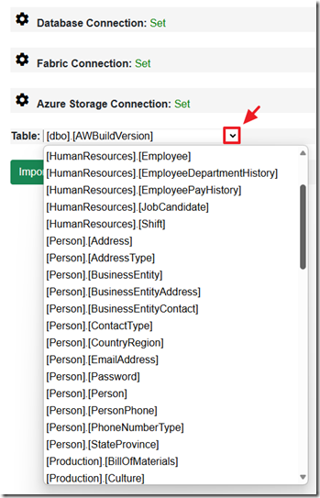
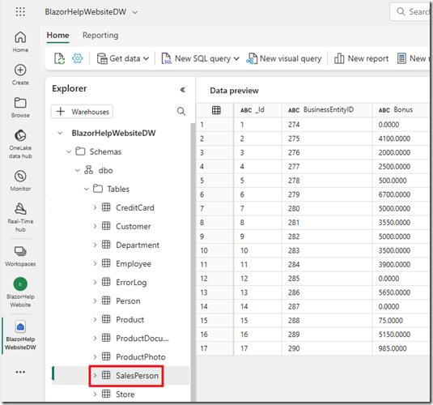
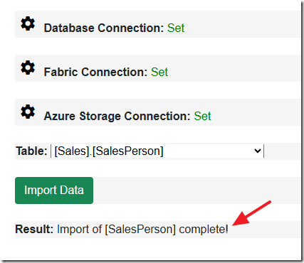







Slide 34
The Code

Slide 35





Slide 36
The ImportSQLIntoFabric Class

Slide 37






Slide 38

Blazor Data Sheet (Fabric)

Slide 39
Using Parquet Files To Update Data
Delete rows that have been removed or updated
TSQL will be used for this step because deleting data is a fast process
Any rows that are removed from the DataSheet will be deleted
Any rows that are updated in the DataSheet will be deleted (to be added in the subsequent step)
Create parquet file from the data
Parquet is a the native format of data in the Fabric warehouse. However, it is being used in this instance as a way to compress the data into a format that is easily imported into Fabric
Any rows that are added in the DataSheet will be added
Any rows that are updated in the DataSheet will be added
Import Parquet file into Azure Storage
The parquet file must be placed in a location that allows the TSQL statement: COPY INTO to import the data. Azure Storage provides such a location. a SAS token will be created to allow Fabric the authentication to access the parquet file
Use COPY INTO to import the parquet file into Fabric
This TSQL statement can import a parquet file that has a million rows in seconds.
Create parquet file from the data
Import parquet file in Azure storage
Use COPY INTO to import the parquet file into Fabric
Delete rows that have been removed or updated
Add new rows
Add updated rows

Slide 40
The Application

Slide 41










Slide 42
The Code

Slide 43


Slide 44

Updating Data

Slide 45

When the Save button is pressed, the data in the Blazor DataSheet is turned into a DataTable. This DataTable is compared to a DataTable that was created when the Blazor DataSheet was first loaded.
This allows the code to determine which rows have been deleted, Witch rows have been added, and which rows have been updated.
When rows are deleted, ProcessDeletedRows() is triggered to remove them from the Fabric database. Similarly, new rows are handled by ProcessInsertedRows(), and changes to existing rows are processed by ProcessUpdatedRows().
Once these operations are complete, if any updates exist, the system imports the modified data into the Fabric environment using a parquet file.

Slide 46

The code then creates an instance of the ImportDataTableIntoFabric class, which is responsible for importing data into Fabric.
It sets various properties of the objImportDataTableIntoFabric object, including the DataTable, table name, Fabric connection string, and Azure storage account details.
The code then calls the ImportDatAsynca() method of the objImportDataTableIntoFabric object, which performs the actual data import process. This method returns a message indicating the result of the import.

Slide 47

The ImportDataTableIntoFabric Class
This code defines the ImportDataTableIntoFabric class that facilitates the process of importing the data into the Fabric Data Warehouse through Azure Blob Storage using Parquet format.
The main method ImportDataAsync parses the DataTable and extracts data, and transforms the result set into a Parquet table.

Slide 48

It then writes the table into an in-memory stream and uploads it to an Azure Blob Storage container.

Slide 49

After uploading the data, a SAS (Shared Access Signature) token is generated, which allows access to the blob with limited permissions.

Slide 50

This SAS token is used to construct a SQL script that constructs the SQL command for performing a bulk data load using the COPY INTO command.

Slide 51

Finally the script is executed to import the data.

Slide 52

Report Data using Blazor

Slide 53















Slide 54
Create The Project

Slide 55














Slide 56
Note: ODBC needs to be used for reports that use Fabric as a data source
ODBC Configuration:
Page One (in Advanced section):
DRIVER={ODBC Driver 17 for SQL Server};Server=*Fabric Server*
Page Two:
User Id=*Service Principal ClientID* Password=*Service Principal Client Secret* Authentication=ActiveDirectoryServicePrincipal

Slide 57

All Resources Files / Tutorials
https://blazordata.net

Slide 58

Get .NET 9
Download .NET 9 aka.ms/get-dotnet-9

Slide 59
Thank you

